Slide 1
DNA ANALYSIS & HEALTH
EXPLORATORY DATA ANALYSIS
ERIKA KVALEM SOTO

Slide 2


WHY?

Slide 3
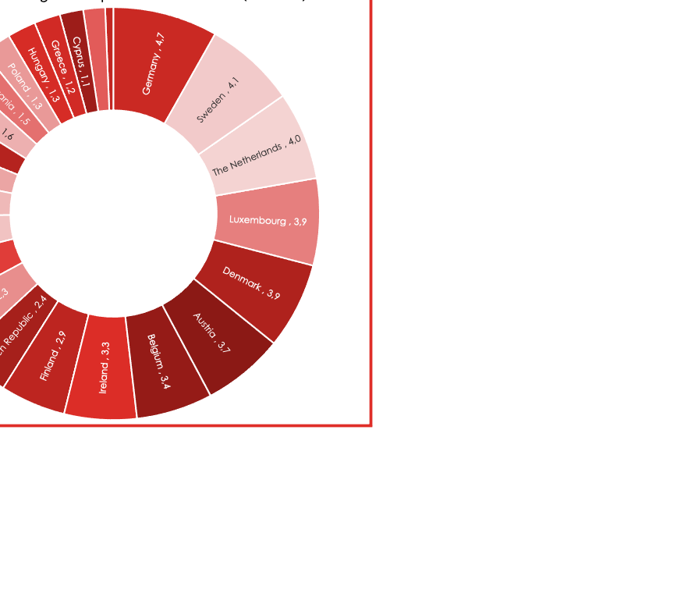
HEALTH ECONOMICS

Slide 4
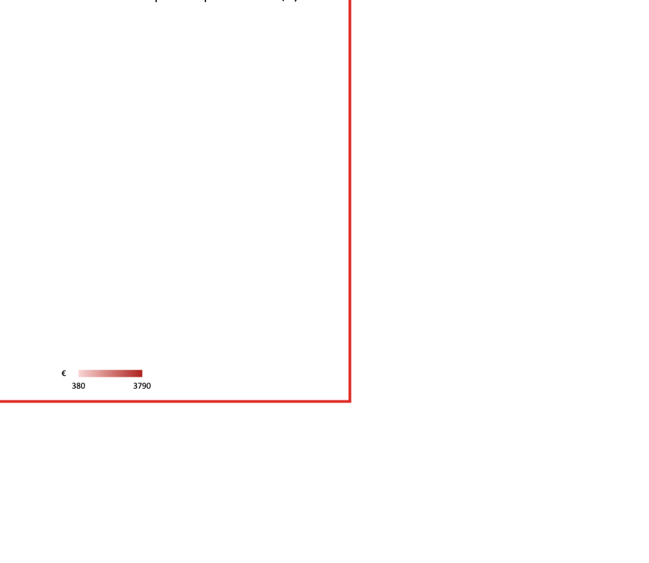
CARDIOVASCULAR DISEASES

Slide 5

ALZHEIMER’S

Slide 6

HOW?
Genome analysis

Slide 7


Subjects of study
Zeeshan-ul-hassan Usmani
Daniel Gago Castro

Slide 8
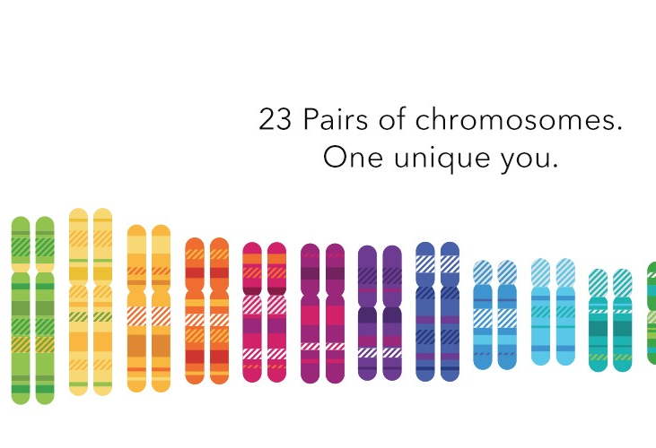

23andme & Myheritage

Slide 9
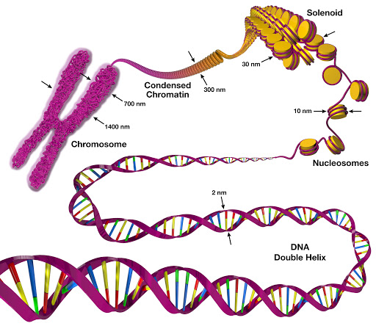
Raw data
3 billion base pairs
(A,T,G,C)
human genome:
23 pairs of chromosomes

Slide 10
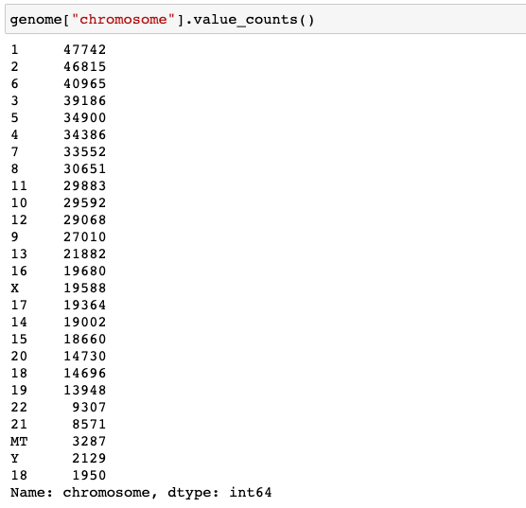
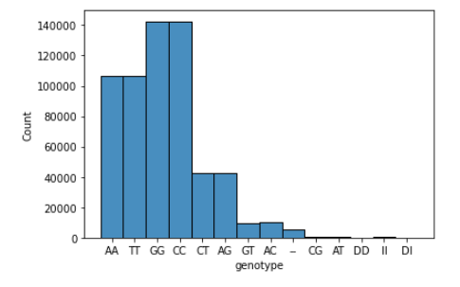
23 pairs of chormosomes

Slide 11
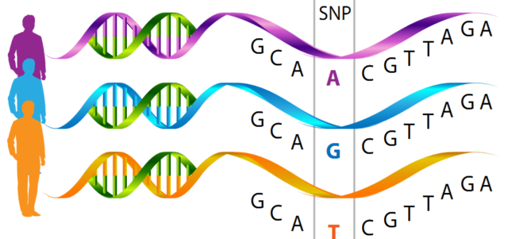
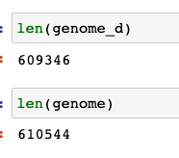
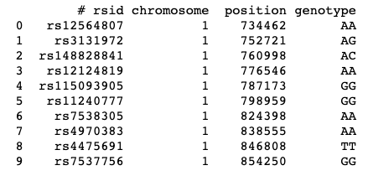
SNP
Singular nucleotide polymorphism

Slide 12
RESULTS
Zeeshan-ul-hassanUsmani
SNP | Feature studied | Phenotype
rs1800401 | Eye color | brown/black eyes
rs1426654 | Skin color | Probably light skin
rs1333049 | Cardiovascular disease | 1.5X risk
rs12425791 | Stroke | Normal profile
rs3736309 | Chronic Pulmonary disease | - 0.44 risk
- | Respiratory infection | -
rs1800629 | Neonatal condition | Normal profile
rs8034191 | Lung cancer | Normal profile
rs145999145 | Alzheimer’s | Normal profile
rs1470579 | Diabetes Type II | 1.2X risk
rs17319721 | Kidney Disease | Normal profile

Slide 13
RESULTS
Daniel Gago Castro
SNP | Feature studied | Phenotype
rs12913832 | Eye color | Brown eyes
rs1426654 | Skin color | Probably light skin
rs16891982 | Cardiovascular disease | 1.5X risk
rs12425791 | Stroke | Normal profile
rs3736309 | Chronic Pulmonary disease | Normal profile
- | Respiratory infection | -
rs1800629 | Neonatal condition | Higher risk
rs8034191 | Lung cancer | 1.27X risk
rs145999145 | Alzheimer’s | Normal profile
rs1470579 | Diabetes Type II | 1.2X risk
rs17319721 | Kidney Disease | Normal profile

Slide 14
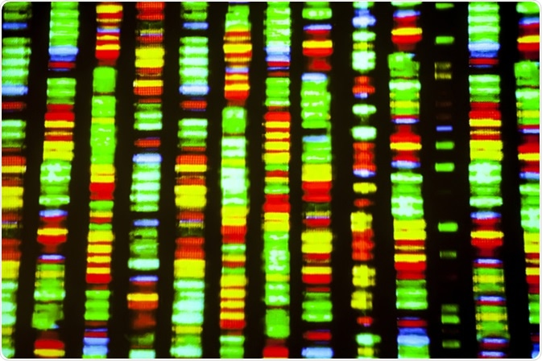
Conclusion
GENOME ANALYSIS HELP TO:
Prevent deadly diseases
Avoid deaths
Rduce economic pressune on health system
Improve society quality of life
ETHICAL ISSUES ARISE
Genetic Data onwership

Slide 15
ANY QUESTIONS? THANK YOU! ☺

